Slide 1
BUS RESERVATION SYSTEM
start………

Slide 2
PRESENTED BY
> Name : patel kathit
> Entrolment number : 21162121023
> ESFP - 2

Slide 3
ABOUT PROJECT
> A bus reservation system is a mobile or web software solution designed to provide customers with a personalized easy-to-utilize user experience for booking and purchasing tickets online. It stores customers’ personal data records, scheduled routes, frequent trips, drop points, and other information.
> You can implement real-time seat availability, multiple payment gateways, offer seat map functionality, and other features. A transport booking eliminates human factor risks and improves conversion rates for your business.

Slide 4
CONTENT IN PROJECT
> 1) Add New Bus Number :- This Feature Creates A New Bus Details Conatining It’s Bus Number, Bus Driver Name, Arrival Time, Departure Time, Initital Destination And Final Destination.
> 2) Reservation :- This Features Allows User To Reserver His/Her Bus Number, Seat Number And Passenger’s Name.
> 3) Show Reservation :- This Feature Allows User To Show His Reservation By Entering His/Her Seat Number. And It Will Show How Many Seats Are Empty And His/Her Reserved Seat Number.

Slide 5
> 4) Buses Available :- This Feature Will Show The Availability Of Buses And Give All The Details Of That Particular Bus Like Bus Number, Driver’s Name, Arrival Time, Departure Time, Final Destination And Initial Destination.
> 5) Exit :- This Feature Will Allow User To Exit From The Program.

Slide 6
HEADER FILES USED
> #include <iostream>
> #include <string.h>

Slide 7
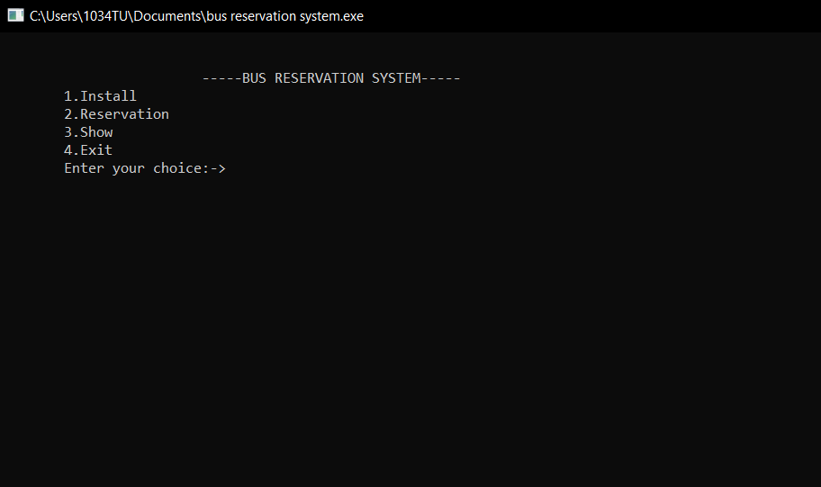

Slide 8
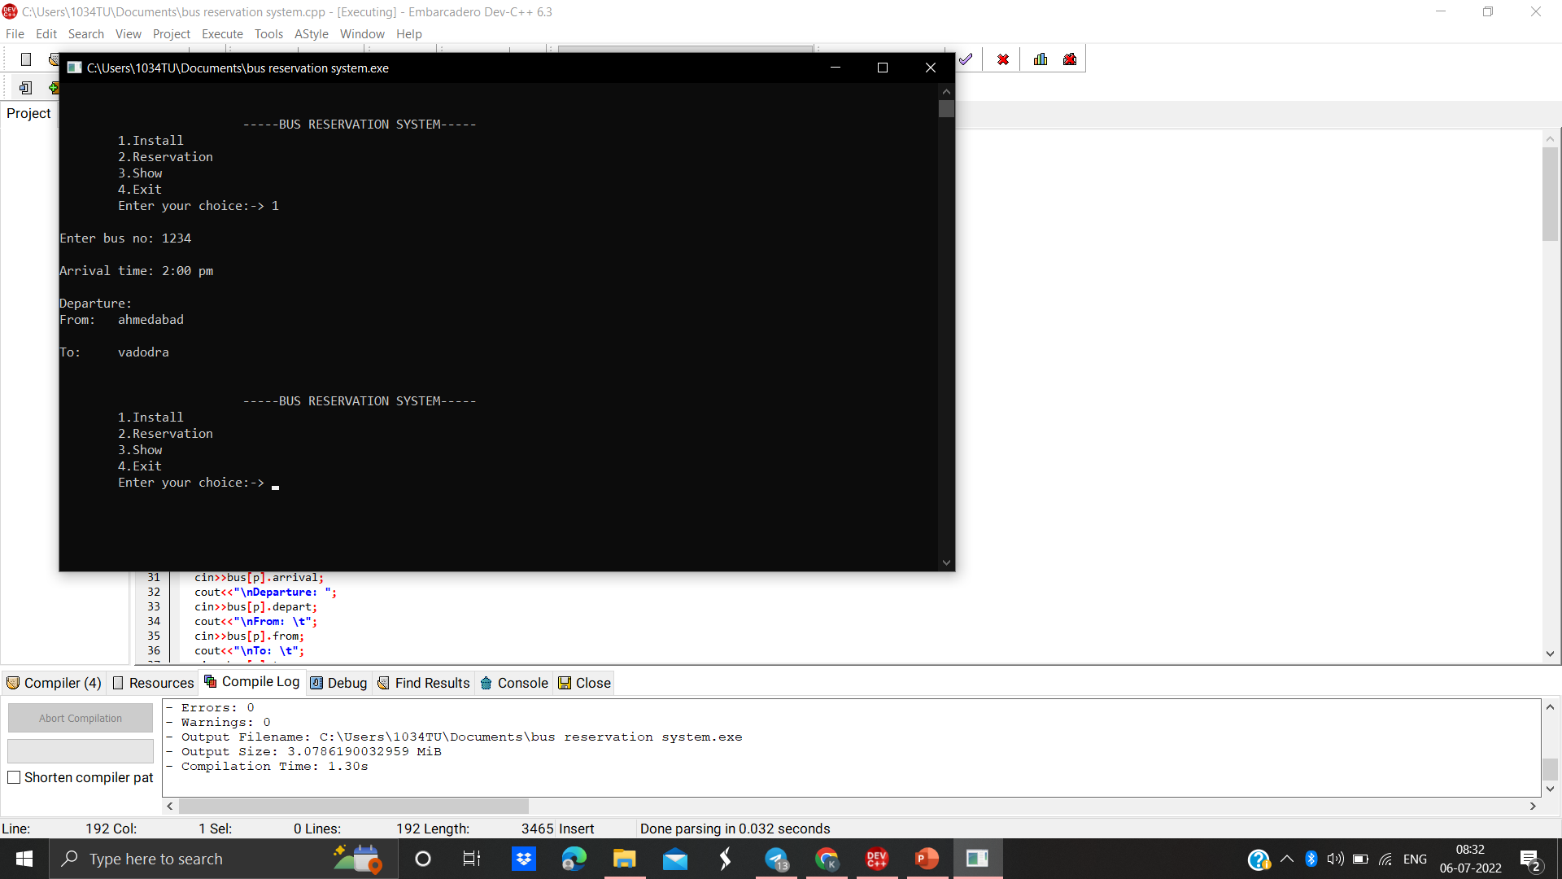

Slide 9
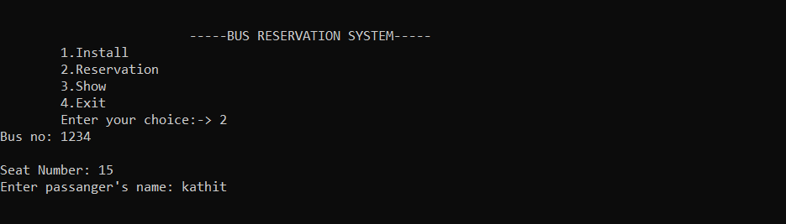

Slide 10
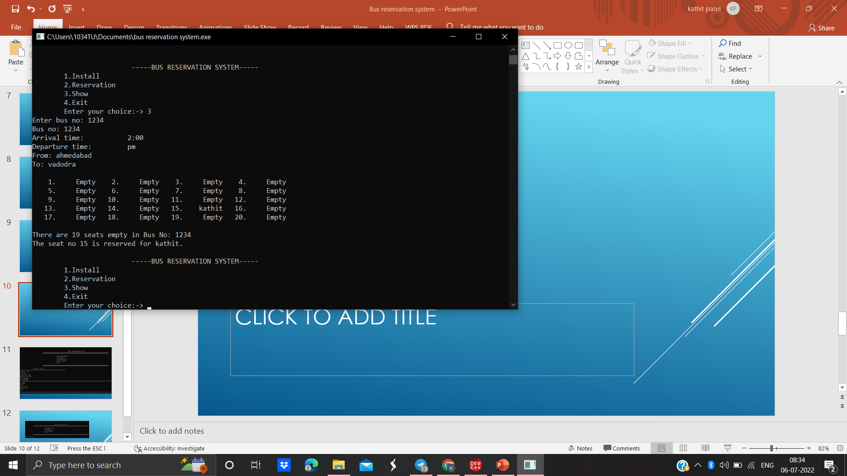

Slide 11
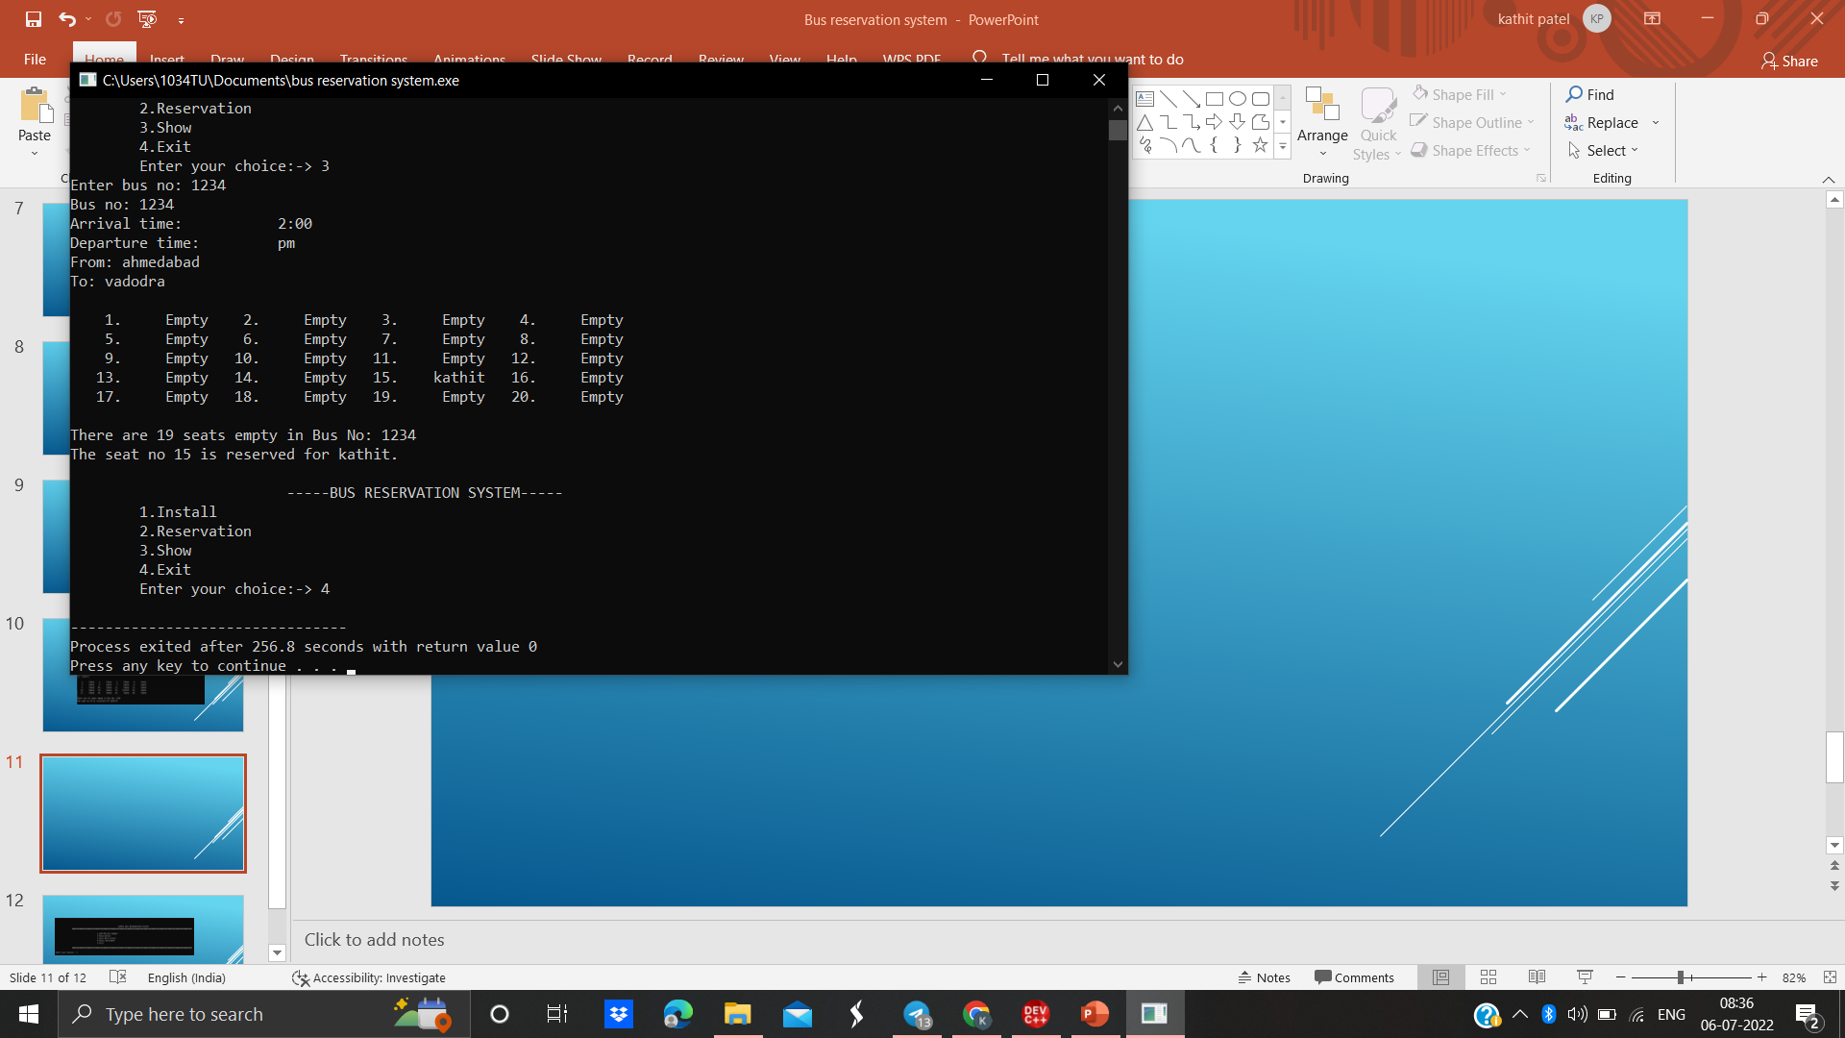

Slide 12
> Thank you <

